Slide 1

Lecture 2: Animation & Graphics
Topics: Animation, Graphics, Drawing

Slide 2
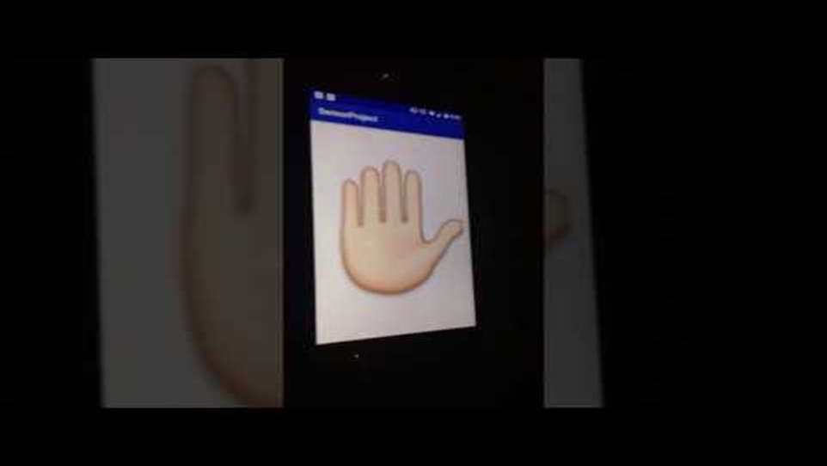
High Five!
https://youtu.be/uFpoXq73HHY

Slide 3
Concepts

Slide 4
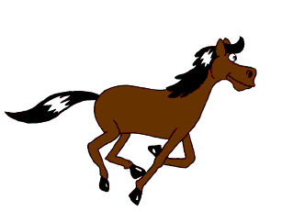
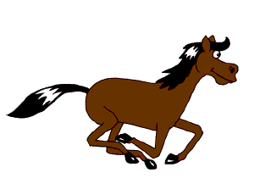
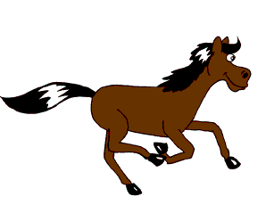
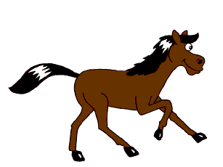
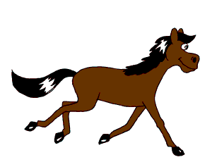
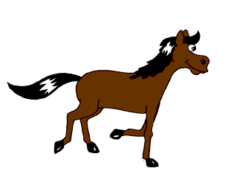
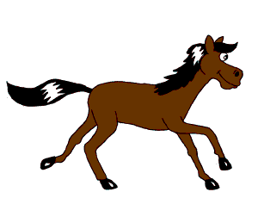
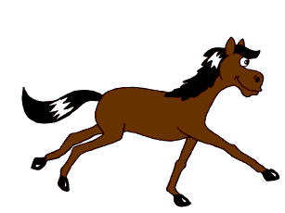
What is Animation?
To create an illusion of motion or change.
By rapid succession of sequential, minimally different images.
By Janke - Own work, CC BY-SA 2.5
https://commons.wikimedia.org/w/index.php?curid=433430

Slide 5
What is (Computer) Graphics?
To generate/Synthesize images using computers.
e.g., pixel arts, sprites, vectors, 3D
Tools/API: OpenGL, Vulkan, Direct3D
A 2D graphic (tree) is synthesized by using basic shapes (circles and a rectangle)

Slide 6
Android: Source and Resource
Source: e.g. .java
Resources: e.g. layout, string, bitmap, animation.
  Benefits: multiple languages, multiple screens, easy to manage.
Resource
aapt
tool
R.java
Packed Resources
Source
Compile
classes.dex
Libraries
Can you guess how to implement animations in Android?

Slide 7
Android: What is a Drawable?
Drawable – Something that can be drawn.
It’s more than just an image/bitmap.
Drawable ≠ View (e.g. can’t receive events)
Various Types of Drawables
Bitmap | Shape
9-Patch | State
 | Transition
 | Animation

Slide 8
Android Animation

Slide 9
Types of Animation
Drawable Animation
View Animation
Property Animation
X(t)
Hello World
Drawable
Animation
View
Animation
Property
Animation

Slide 10
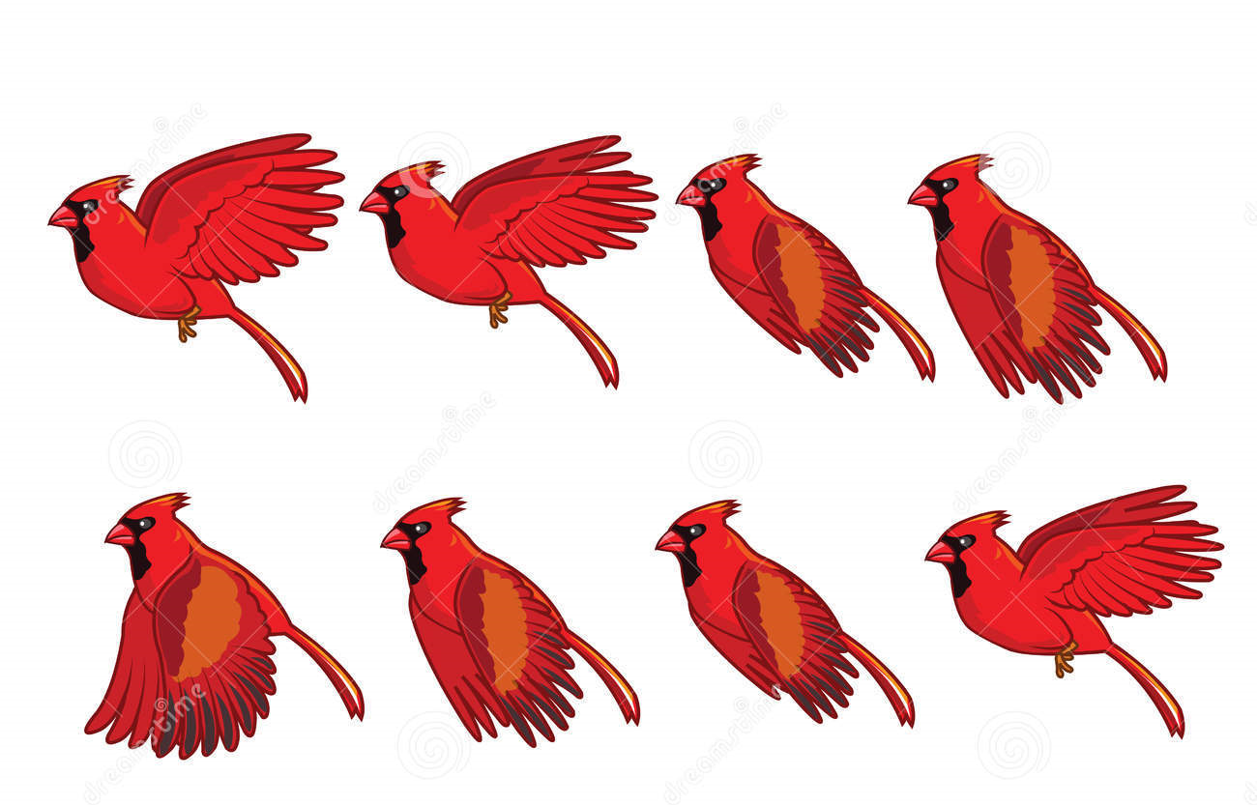
1. Drawable Animation
We can load and display a series of Drawable resources (e.g. images) one after another.

Slide 11
1. Drawable Animation
Define animation-list in XML: res/drawable
Use AnimationDrawable inside your Java code to start the animation
XML:
<?xml version="1.0" encoding="utf-8"?>
<animation-list xmlns:android="http://schemas.android.com/apk/res/android"
android:oneshot=“false">
<item android:drawable="@drawable/pic1" android:duration=“1000" />
<item android:drawable="@drawable/pic2" android:duration=“1000" />
<item android:drawable="@drawable/pic1" android:duration=“1000" />
<item android:drawable="@drawable/pic2" android:duration=“1000" />
</animation-list>
Java:
someImgView.setBackgroundResource(R.drawable.abovexml);
((AnimationDrawable)someImgView.getBackground()).start();

Slide 12


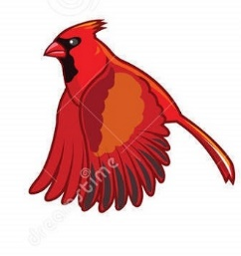
Try this
Get some images and put into: res/drawable/
Create an XML file: res/drawable/my_anim_list
Add an ImageView and set Background
Use AnimationDrawable to start animation

Slide 13

2. View Animation
You can animate a View e.g., by scaling, rotating, and translating an ImageView.

Slide 14
2. View Animation
Define the Animation in XML: res/anim
Use Animation to fetch it, then apply it to a View.
XML:
<?xml version="1.0" encoding="utf-8"?>
<rotate xmlns:android="http://schemas.android.com/apk/res/android"
android:fromDegrees="0"
android:toDegrees="360"
android:toYScale="0.0"
android:pivotX="50%"
android:pivotY="50%"
android:startOffset=“1000"
android:duration="10000"
/>
Java:
Animation x = AnimationUtils.loadAnimation(
getApplicationContext(), R.anim.abovexmlfile );
someView.startAnimation(x);

Slide 15
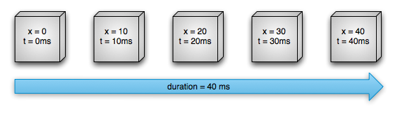
3. Property Animation (Value)
Changing value of a variable over a period:
Use setInterpolator() to change behavior.
ValueAnimator anim = ValueAnimator.ofFloat(0f, 40f);
anim.setDuration(40);
anim.start();
Advantage? and Limitation?

Slide 16
3. Property Animation (Object)
Changing a property of an object.
Hello World
Hello World
Hello World
ObjectAnimator anim =
ObjectAnimator.ofFloat(myTextView, “textSize”, 10f, 30f);
anim.setDuration(5000);
anim.start();
Object
Variable

Slide 17
Summary of Android Animation
List of XML tags and Java Classes:
Animation Type | XML Tag | Java Class
Drawable Animation | animation-list | AnimationDrawable
View Animation | rotate translate scale set | Animation
Property Animation |  | ValueAnimator ObjectAnimator

Slide 18
Android Graphics

Slide 19
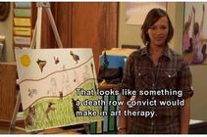
Graphics Approaches
Canvas and Drawables
OpenGL (framework API and NDK)
S2E9

Slide 20
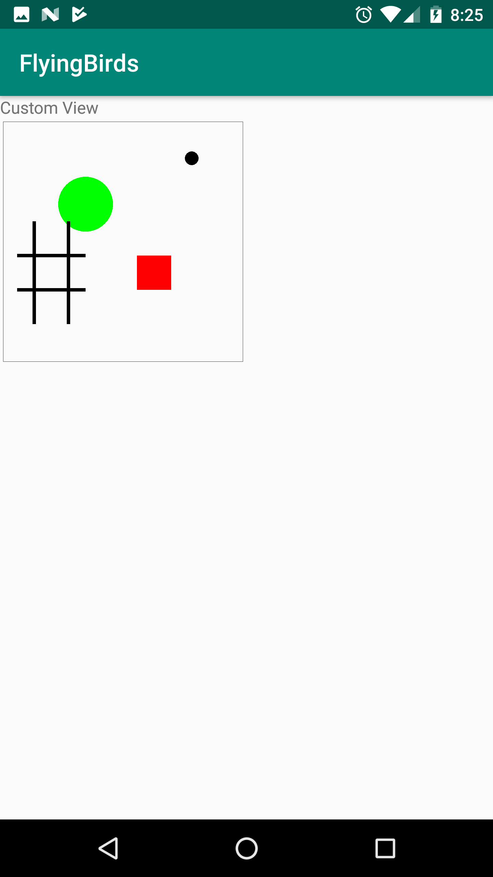
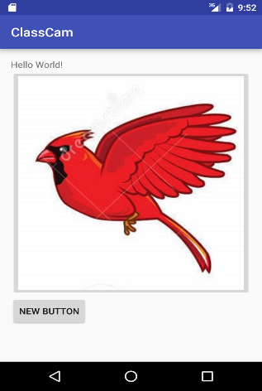

2D Drawing
Using Canvas:
  Draw on Canvas (of a View)
  More work, more control, more efficiency
Using Drawable:
  Put Drawables (in a View)
  Less work, less control, less efficiency
  We have learned it already (e.g., images, animation)

Slide 21
1. Using Canvas
Canvas holds all of your draw*() calls.
Drawing is performed upon an underlying Bitmap.
drawRect()
drawRect()
drawCircle()
…
Canvas (logical)
Bitmap (physical)

Slide 22
1. Using Canvas
Canvas holds all of your draw*() calls.
Drawing is performed upon an underlying Bitmap.
Two ways to use the Canvas of a View:
  Custom View
  Surface View
Bitmap b = Bitmap.createBitmap(100, 100,
Bitmap.Config.ARGB_8888);
Canvas c = new Canvas(b);
Paint p = new Paint();
p.setColor(Color.GREEN);
c.drawRect(10, 10, 90, 90, p);

Slide 23
Custom View
Good for low frame-rate applications (e.g. chess or snake game).
You define a new View and add it in the layout XML file (like you do for a TextView, ImageView etc.)
Android provides you the Canvas as you extend a View and override its onDraw() method.
To request a redraw, use: invalidate(). Outside main Activity’s thread, use postInvalidate().

Slide 24
Custom View
Create your own View Class (CustomView.java)
Use the View in the layout xml
To force a redraw: invalidate()
public class CustomView extends View {
//Declare all four types of constructors here.
@Override
protected void onDraw(Canvas canvas) {
super.onDraw(canvas);
//Use canvas.draw*()
}
}
<edu.unc.nirjon.projectname.CustomView
android:id="@+id/mycustomview"
android:layout_width="match_parent"
android:layout_height="match_parent"
/>

Slide 25
Try this
Create a Custom View
  Draw a rectangular bounding box.
  Draw a point (circle) at a variable location (X, Y)
  Use invalidate() to force redraw.
  Every time the scene is redrawn, the point (X, Y) should move by a certain amount (dx, dy). When the ball hits a wall, it should bounce back and change direction.

Slide 26

2. Using Drawables
Two ways of putting Drawables into a View
Four
ButtonViews
res/drawable/queen.png
res/drawable/tfade.xml

Slide 27
2(a) Image from Project Resource
Copy images into res/drawable/
Use it inside the layout xml
You can also do the same by writing code:
<ImageView
android:layout_width="match_parent"
android:layout_height="wrap_content"
android:id="@+id/img1"
android:src="@drawable/my_image"/>
  ImageView i = new ImageView(this);
  i.setImageResource(R.drawable.my_image);
  LinearLayout ll = new LinearLayout(this);
  ll.addView(i);
  setContentView(ll); //instead of setContentView(R.layout.somexmllayoutfile)

Slide 28
2(b) XML with drawable properties
e.g. Transition Drawable: res/drawable/something.xml
Now, take an ImageView to show it (them):
<transition xmlns:android="http://schemas.android.com/apk/res/android">
<item android:drawable="@drawable/image1">
<item android:drawable="@drawable/image2">
</transition>
TransitionDrawable td;
td = (TransitionDrawable)
getResources().getDrawable(R.drawable.something);
td.setCrossFadeEnabled(true);
ImageView img;
img = (ImageView) findViewById(R.id.img1);
img.setImageDrawable(td);
td.startTransition(5000);

Slide 29
References (study these)
https://developer.android.com/training/animation/
https://developer.android.com/guide/topics/graphics/

